Slide 1
Mantid Scientific Steering Committee
Nick Draper
18/06/2010

Slide 2




Major Tasks presented last meeting
Monte Carlo Absorption correction
  Divergence profile
  Multiple scattering
Finalise and complete ‘Homer’ interface
Inelastic Convert To Energy Interface requirements
Matlab interface
Script repository requirements
Single Crystal requirements

Slide 3
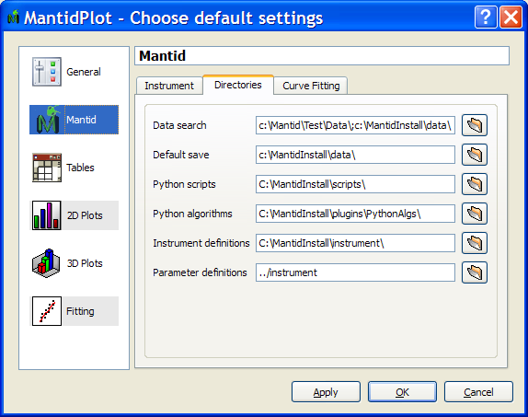
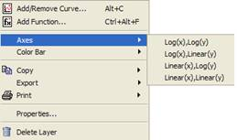
Progress over the last iteration
User interface changes
  New Zoom and Pan tool
  Curve fitting tool moved
  User settable Preferences
    Default Instrument
    Directories
      Data Search
      Default Save
      Python scripts / algorithms
    Curve Fitting defaults
  Default Workspace in Algorithm Dialogs
  Default graph line style, axes
  Easier to change graph axes

Slide 4
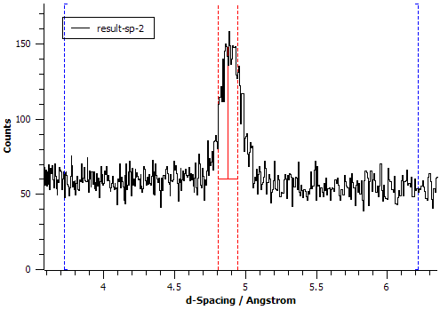
Progress over the last iteration
Curve Fitting
  Automatic selection of Fit region
  Automatic background addition
  Better Peak height estimation for peaks on backgrounds
  Robustness improvements to Ikeda carpenter and B2B exponentional
  User selectable cost function
  Instrument parameters can be specified in a separate Parameter file

Slide 5
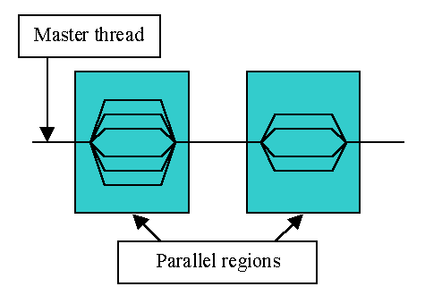
Progress over the last iteration
Performance
  Faster display of Mantid matrices in MantidPlot
  Improvements for
    All unary operations
    ConvertUnits
    ReplaceSpecialValues
    AlignDetectors
    Q1D

Slide 6
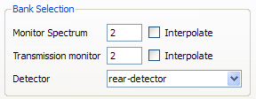
Progress over the last iteration
General
  LoadRawBin0 and Spectrum0
  Log, Exponential and Power algorithms
SANS
  Support for Multiperiod files
    Inefficiently
  Interpolation of monitors for normalisation
  Mirroring in Phi limitation

Slide 7
Progress over the last iteration
Excitations
  User interface generalised to work with all instruments
  Differences with LibISIS isolated and resolved.
Indirect
  UpdateInstrumentFromRaw
Crashes/Bugs
  10 Notable bugs corrected.

Slide 8
Next Release
Target Date
  31st August 2010
Major Items
  SNS
    Load SNS Histogram data
    Load HFIR Sans data
    Load Event Data
    Filter / split event data (script only)
    SNS Instrument definitions
    Powder Diffraction scripts
    Integration with Inelastic Convert To Energy GUI
    Investigate SANS user interface suitability

Slide 9
Next Release
Major Items
  ISIS
    Muon GUI implementation
    Indirect ConvertToEnergy GUI
    SANS GUI improvements
    File loading by specifying 556 or 1012, or WISH324
    Icat searching interface
    Script library integration
    Ikeda carpenter & B2B fits on any unit
    Easy user control for plotting distribution data
    Sequential Peak fitting and plotting vs log values
    Improved NumPy integration
    Continued work on Monte carlo absorption correction
    Matlab interface?

